Slide 1
Administration
Project 4
Due Today
See: Autograder Output Forum Post (run_test.sh –c)
Formatting is secondary to correctness
Partner Evaluations
Office Hours by appointment as of Wednesday
“Late-Feature” Projects, switching to grading focus
Course Evaluations
Today: Class as-a-whole, Instructor
Friday: TAs
Last Quiz on Friday
Security topics from today
Windows-version review of some topics after
Discussion Questions

Slide 2
PollEV Warmup
PollEv.com/wpi3013c01
OSTEP Chapter 39: Files & Directories

Slide 3
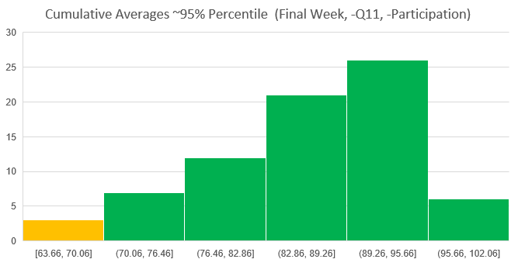
Class State
Grading Delay Refund (+10% Project)
89.5 >= A, 79.5 >= B, 69.5 >= C
Course Evaluation & Dept. TA/SA Evals
Additional ++ ?

Slide 4

OS Protection
Operating
System

Slide 5


A Simple Definition of Security
An asset is secure if, and only if,
>
perceived cost to
compromise the asset
perceived value
of the asset

Slide 6
Perception and Reality

Slide 7
Common Theme
Stories
Relevant Research Projects
MQPs?
Jobs/Internships?
Scholarship for Service Program

Slide 8
Cyber Security and Game Theory
Active opponents
Cat and mouse game
It’s not whether you root or not, it’s how you exploit the system
No preying on newbies
What do attackers call “Winning Dirty”?

Slide 9
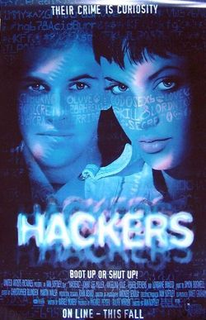
Adversaries
Intruders/Attackers
Divine intervention
System errors
Human error
A word on insider threats

Slide 10
Who Goes There? Authenticating People
Usernames and Passwords
Biometrics
Multi-factor authentication
What you know
What you have
What you are
Where you are
When you are
Who confirms you

Slide 11
Insider Attacks
Logic bombs
Trap doors
Code reviews
Login spoofers
Why ctrl+alt+delete?

Slide 12
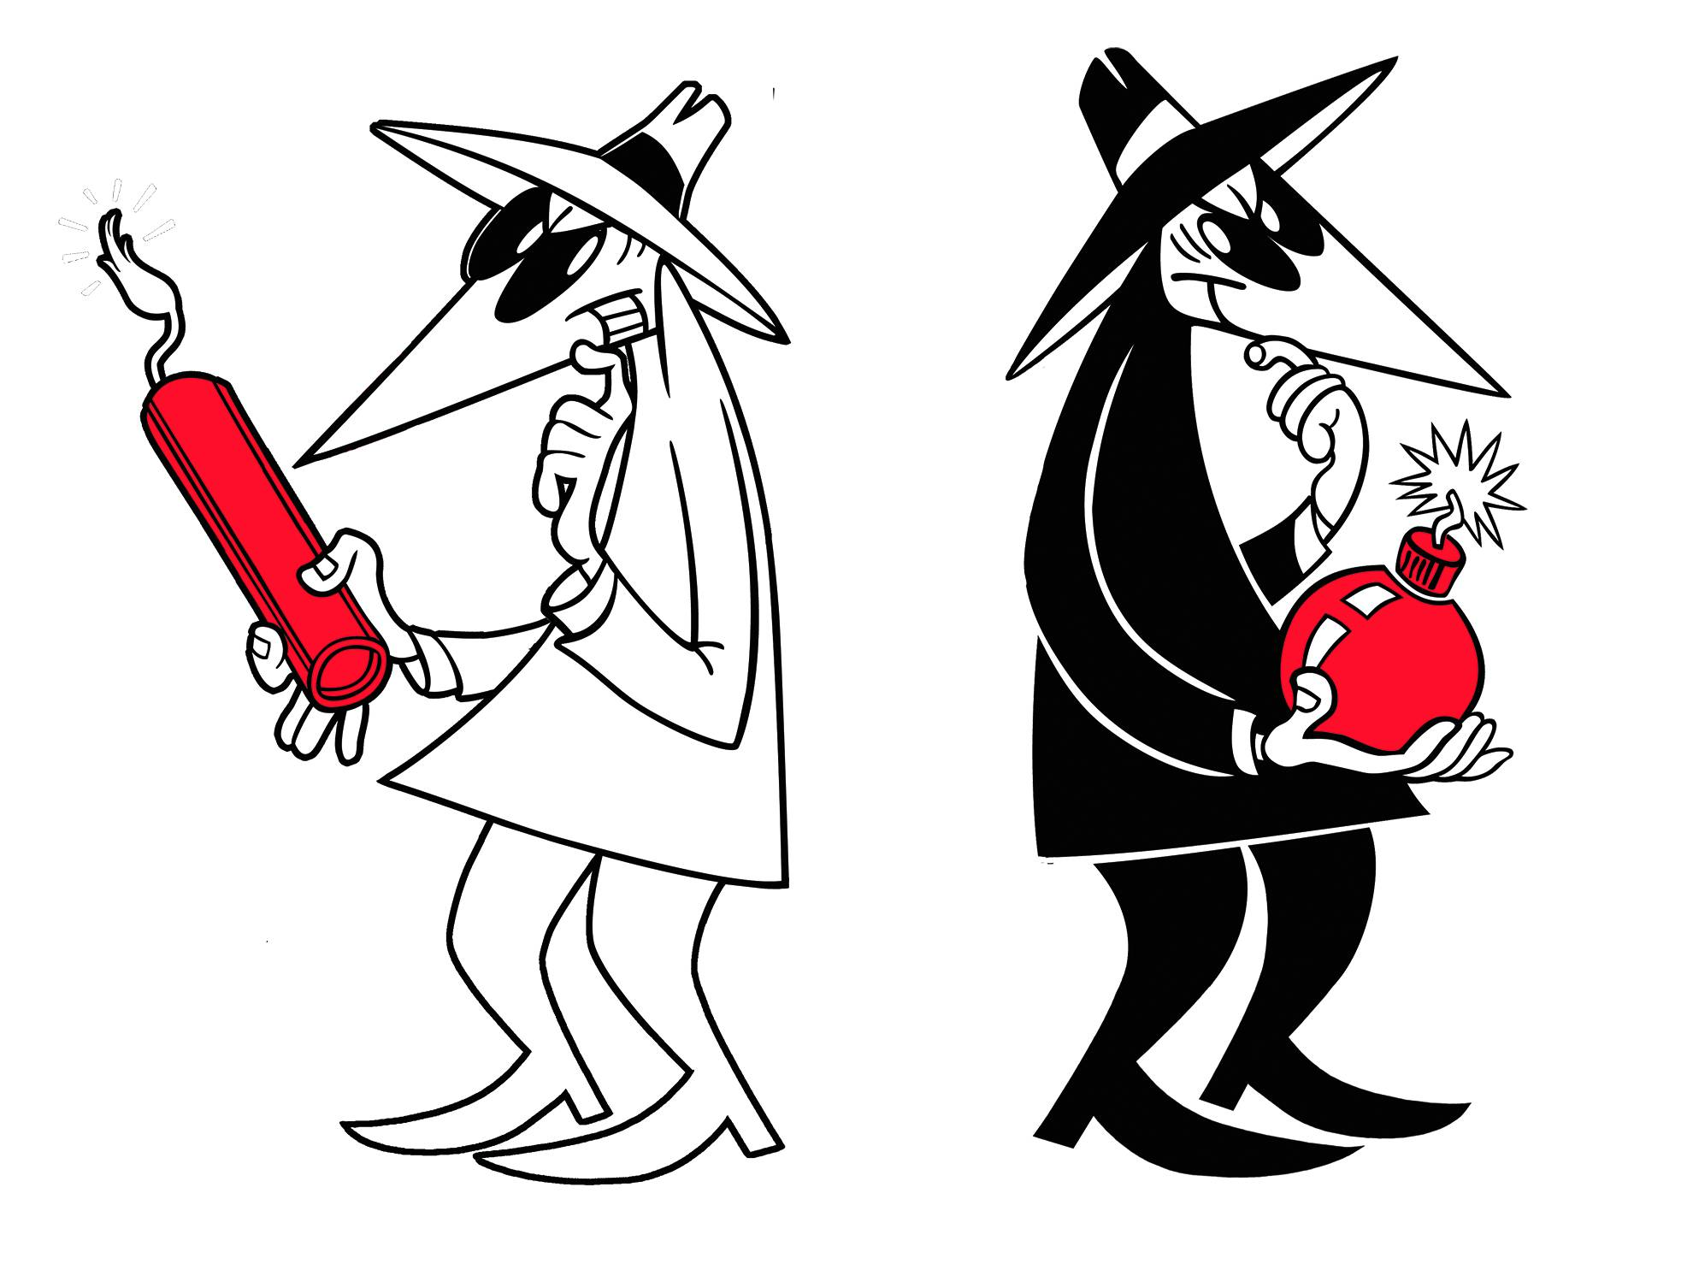
Focus: Insider Threat

Slide 13
Insider Threat
Malicious actors within an organization
Motivations
Competitive Advantage
Financial Gain
Of surveyed organizations in 2007
49% had at least one deliberate insider incident within last year
One organization lost $100 million (including intellectual property) as a result

Slide 14
Some attacks cost more than money
WikiLeaks exposure of US Department of State diplomatic cables
Perpetrated by DoD insider
Chelsea Manning
Increase foreign tension with US
Increased risk to US allies
Edward Snowden?

Slide 15
An Example: Payroll
Payroll manager authorized to manage accounts, transfer funds
Within own authority, manager could
Add a fraudulent payee
Pay the payee
Delete the payee from the system
Hard to systematically detect abuse without considering the context

Slide 16
Prior work: A battle with complexity
System log examination
Often too sparse, hard to link actions
System call behavior
Example: all fopen, fread, fclose calls
Overwhelming complexity
Difficulty of interleaved activities

Slide 17
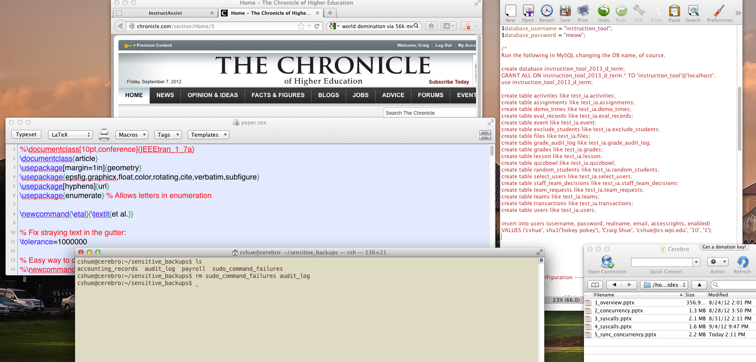
The Big Picture

Slide 18
OCR and Keywords

Slide 19
Auditor Console

Slide 20
Exploiting Bugs
Buffer Overflow Attacks
String format attacks
Causing printf to change memory
Return to libc Attacks
Integer Overflow Attacks
Code Injection Attacks
Privilege Escalation Attacks

Slide 21
Malware
Backdoor
Zombies and Botnets
Keylogger
Identity Theft
Viruses, Trojan Horses, Worms
Parasitic Viruses
Memory Resident
Interrupt Vector?
Boot Sector

Slide 22
Malware (2)
Device drivers
Macro viruses
Source code viruses
Spyware
Drive-by Downloads
Browser Hijacking
Rootkits

Slide 23
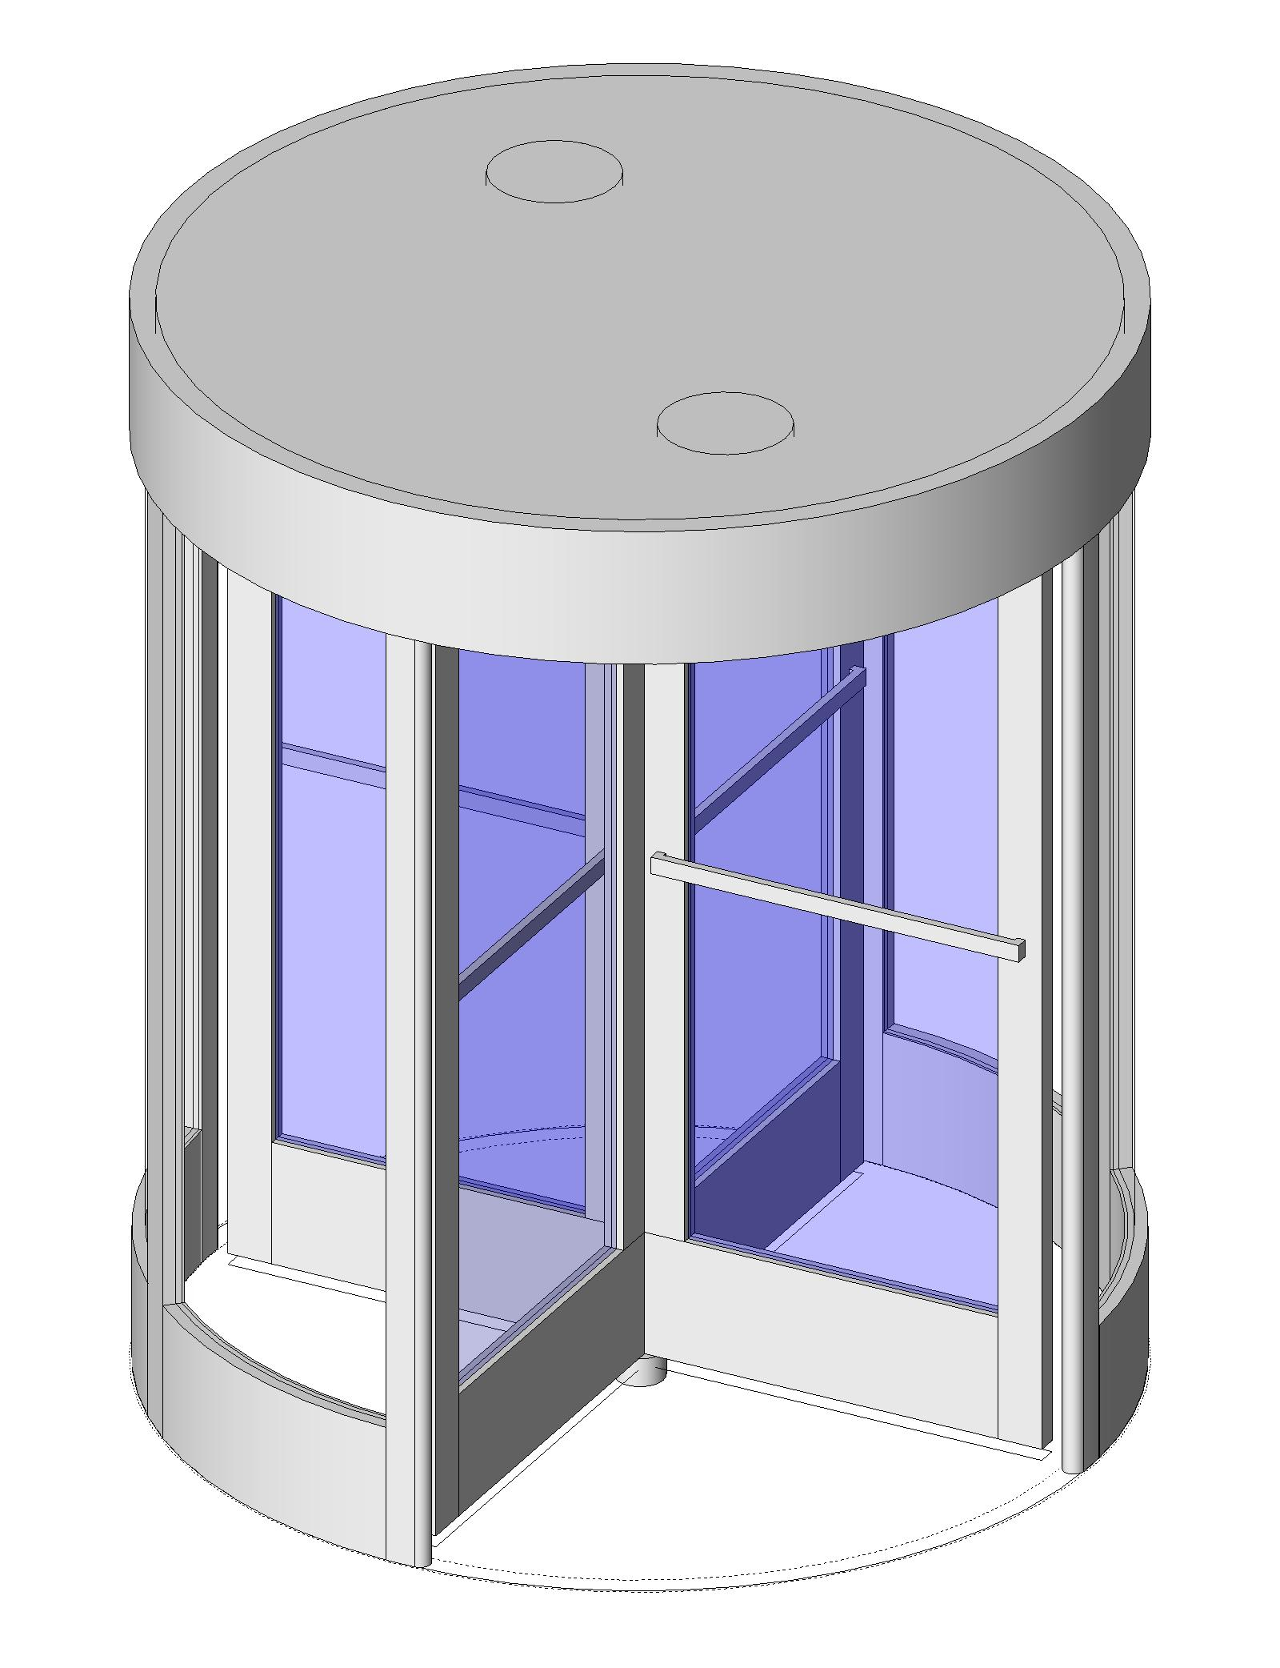
USB-ARM’s Revolving Door
Norton
ClamAV
McAfee
Anti-Virus

Slide 24
Protection
Security and Protection Mechanisms
Goals:
Data confidentiality
Data integrity
System availability
Exclusion of outsiders
Privacy?

Slide 25
Protection Mechanisms
Protection Domains
(object, rights) pairs
Principle of Least Authority
UIDs/GIDs
ACLs
Object, with subject that can access them
Capabilities
Ability to hand capabilities to others

Slide 26
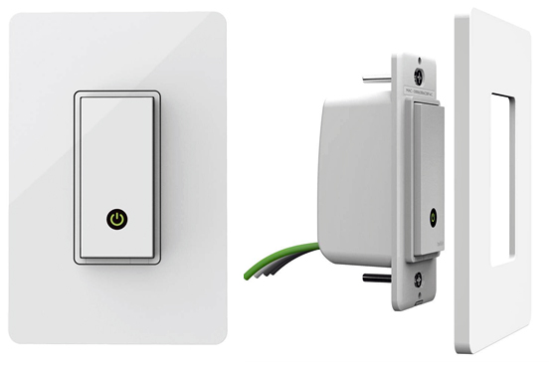
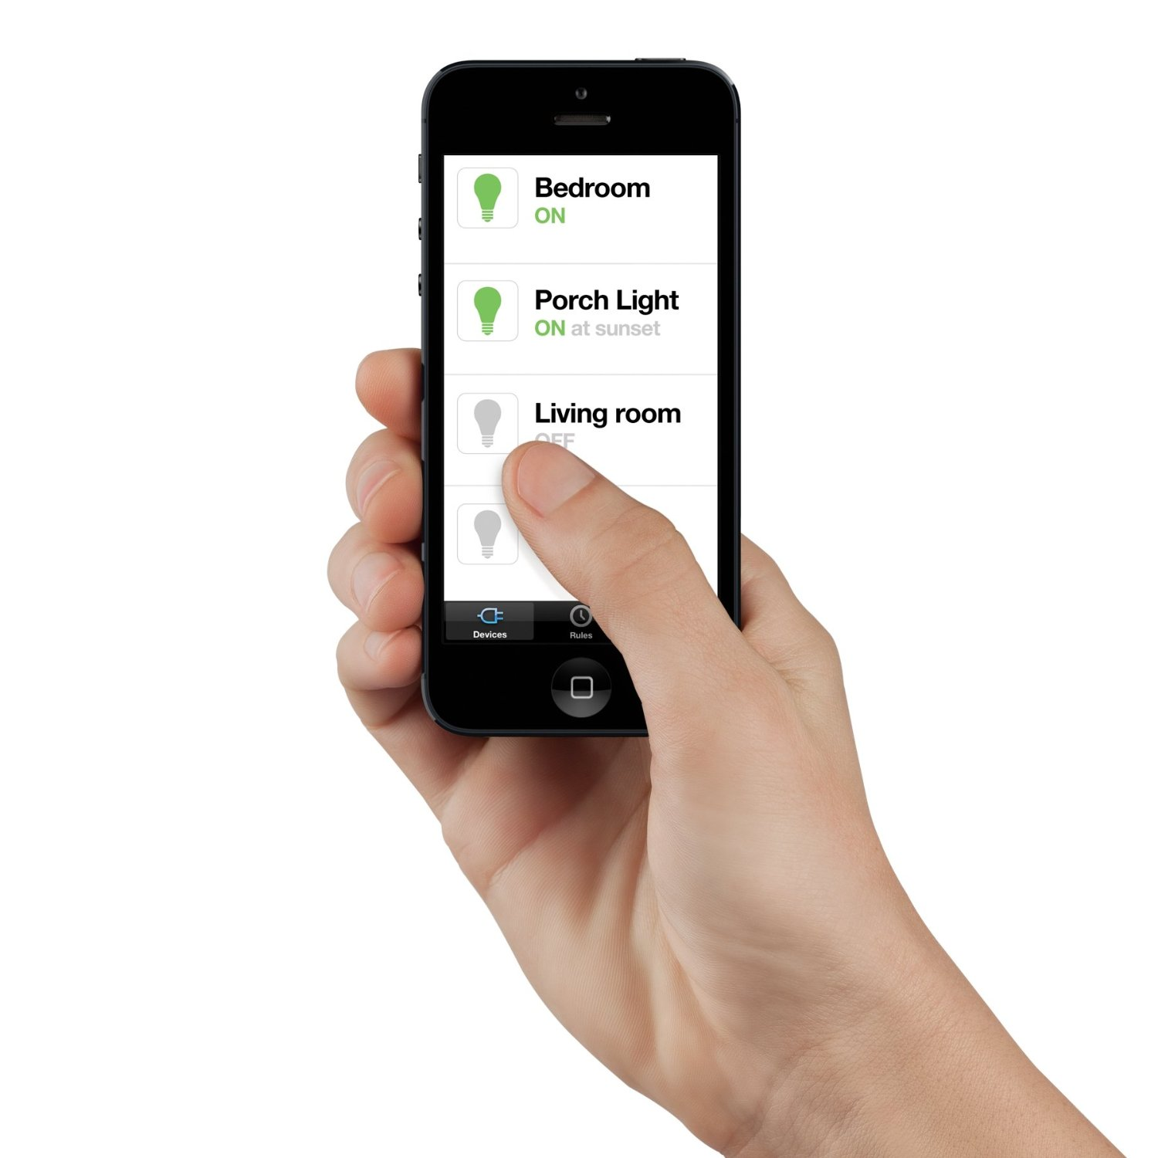
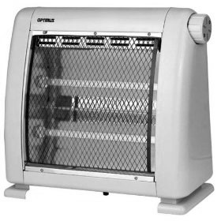
Focus: The “Internet of Things”
Remote controlled light switch
Turn Off
Turn On

Slide 27
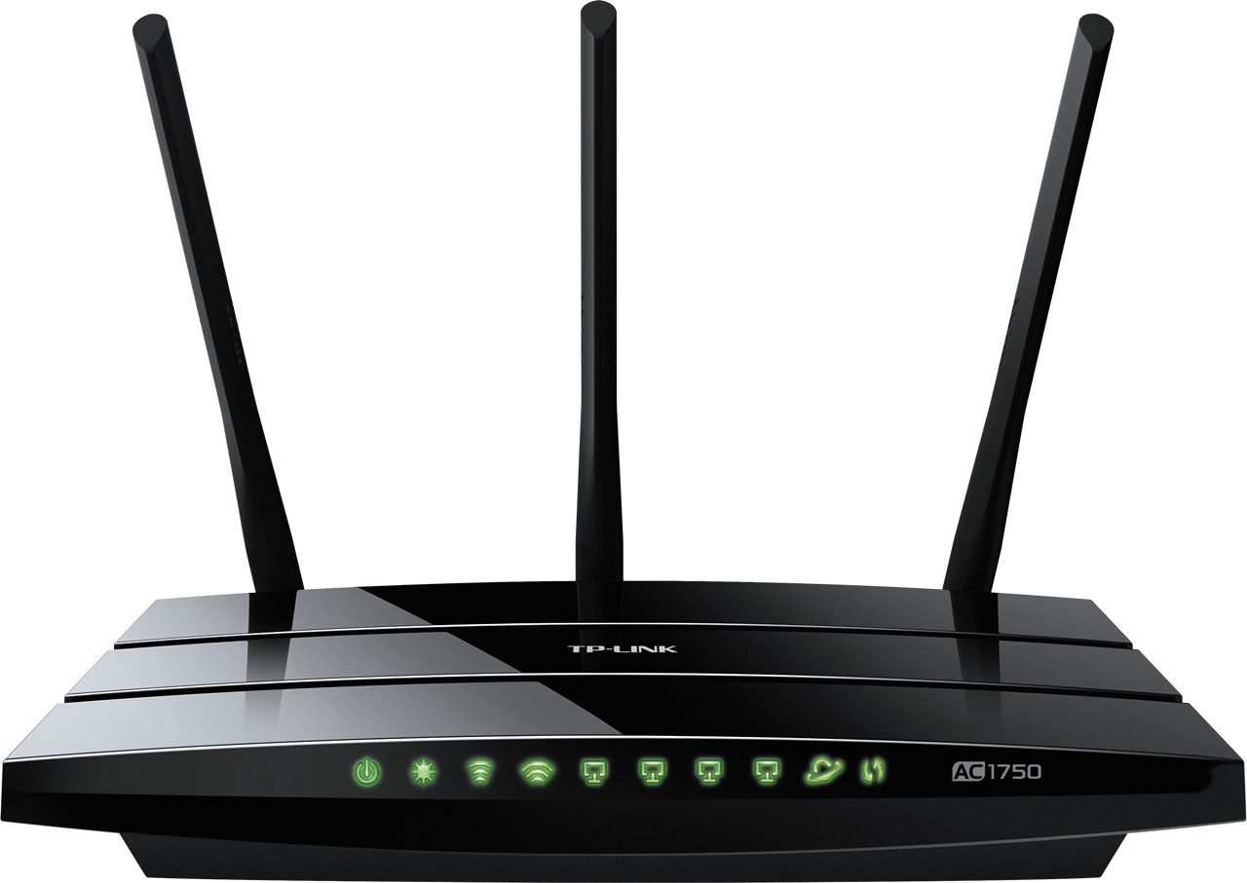


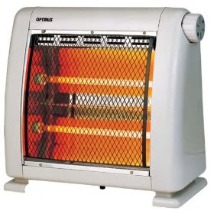
IoT: Creating and Enforcing Policy
Security Proxy
Is this too frequent?

Slide 28
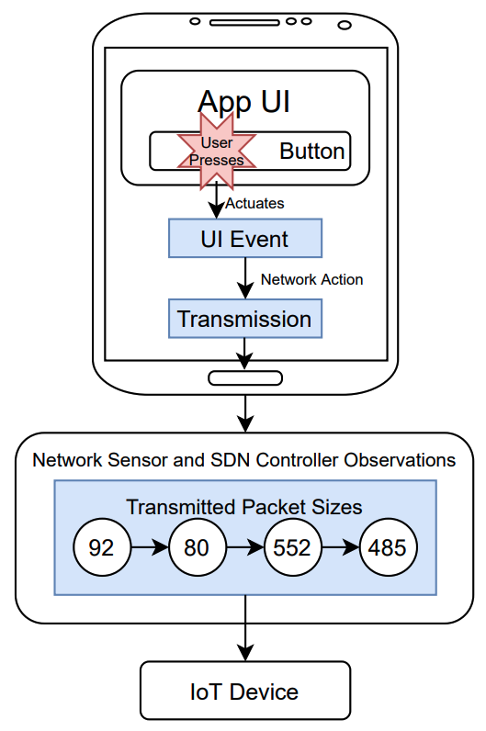
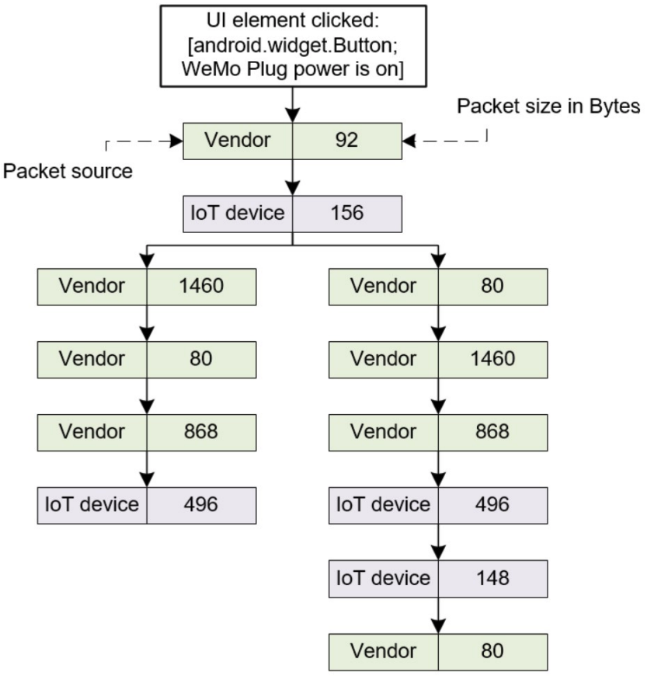
IoT: Access Control State Machines
Zorigtbaatar Chuluundorj, Shuwen Liu, Craig A. Shue, "Generating Stateful Policies for IoT Device Security with Cross-Device Sensors," IEEE Network of the Future (NoF) Conference, October 2022. This paper received the NoF best paper award.

Slide 29
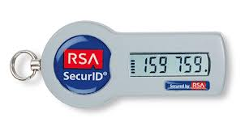
Crypto 101
Plaintext -> Ciphertext
Conversion uses key
Algorithm public
!Security by obscurity
Secret key crypto
Public key crypto
One way hash functions
Digital signatures
Certificate Authorities/PKI
Trusted Hardware / TPMs

Slide 30
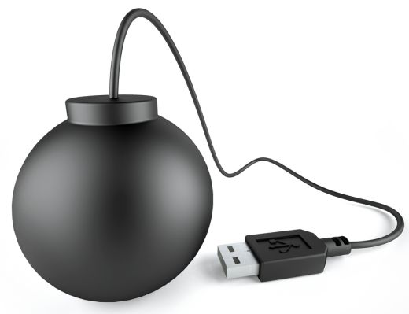
Focus: USB-ARM

Slide 31
Focus: Corporate Network Need: Situational Understanding
Internet
Router
Intrusion Detection System
Switch 1
Switch 2
Host 1
Host 2
Host 3
Host 4
Host 5
Host 6
Host 7

Slide 32
Need: Situational Understanding
Internet
Router
Intrusion Detection System
Switch 1
Switch 2
Host 1
Host 2
Host 3
Host 4
Host 5
Host 6
Host 7

Slide 33
Our Approach: Pre-approve Traffic
Internet
Request to Allow Connection
Source: Chrome run by “cshue”
URL: host4.example.com
Router
Controller
Switch 1
Switch 2
Host 1
Host 2
Host 3
Host 4
Host 5
Host 6
Host 7

Slide 34
Our Approach: Pre-approve Traffic
Internet
Router
Controller
Host 1 initiates
connection to Host 4
Switch 1
Switch 2
Host 1
Host 2
Host 3
Host 4
Host 5
Host 6
Host 7

Slide 35
Our Approach: Pre-approve Traffic
Internet
Request to Allow Connection
Dest: Apache2 run by “www”
Installed as admin service
Router
Controller
Switch 1
Switch 2
Host 1
Host 2
Host 3
Host 4
Host 5
Host 6
Host 7

Slide 36

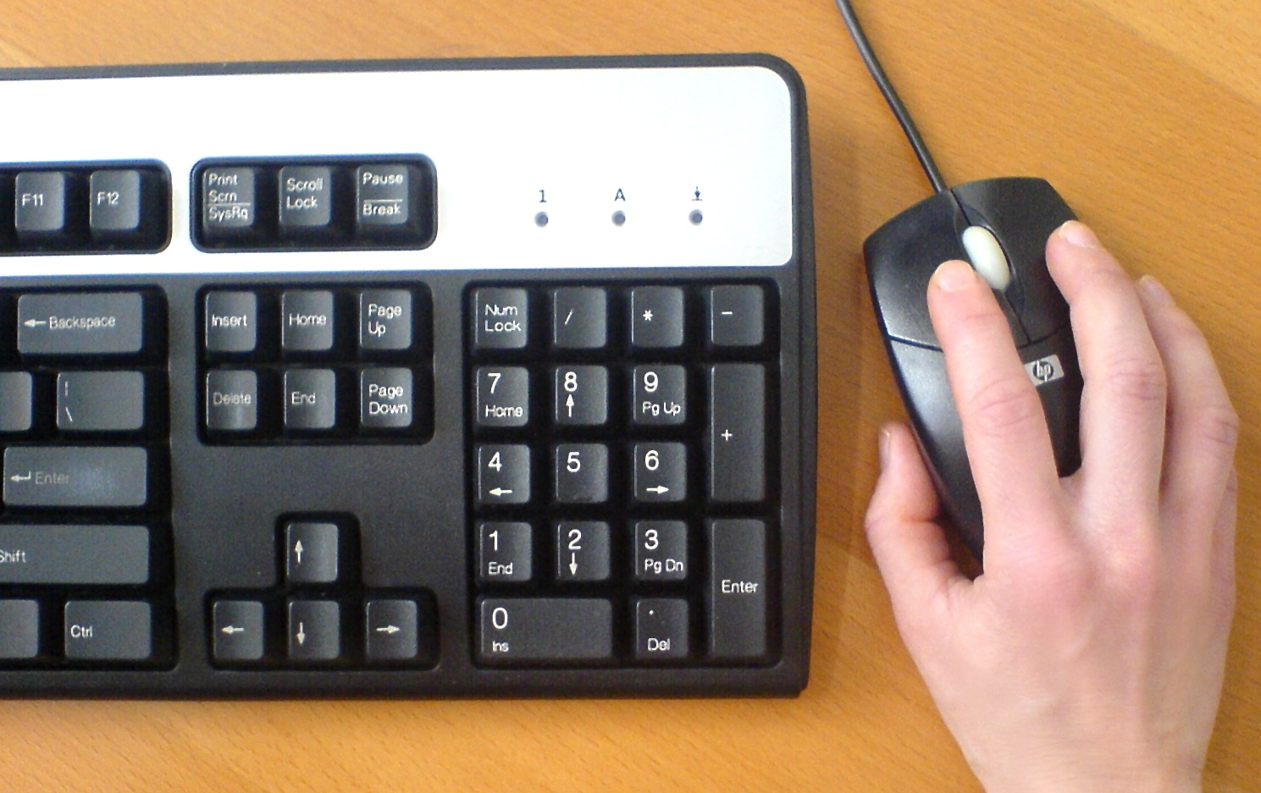
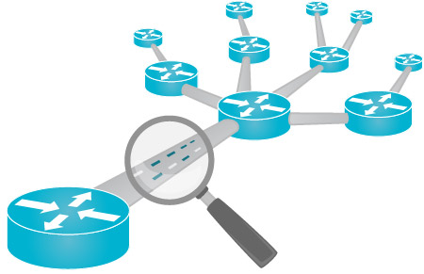
Golden Nugget: Host-based Control
Deeper insight:
Link user actions and applications with network traffic
Can see the text on the screen to make decisions
+
+
User-entered URL
Last keystroke/click
Network traffic analysis
Evidence for Informed Security Decisions

Slide 37
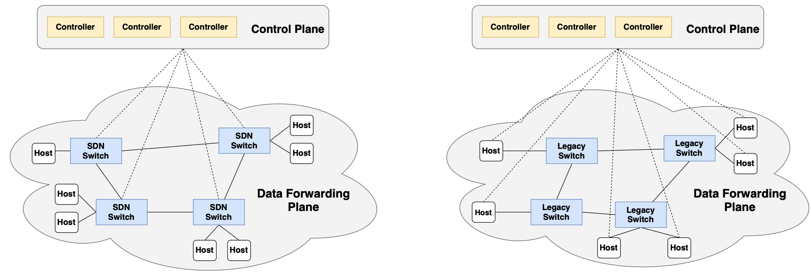
MQP: Endpoint Security Earns Best Paper Award
Yunsen Lei, Julian P. Lanson, Remy M. Kaldawy, Jeffrey Estrada, Craig A. Shue, "Can Host-Based SDNs Rival the Traffic Engineering Abilities of Switch-Based SDNs?," IEEE Network of the Future (NoF) Conference, October 2020. This paper received the NoF best paper award.

Slide 38
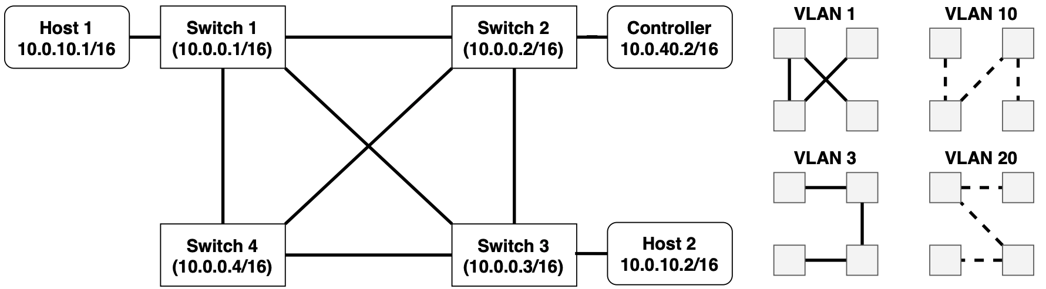
MQP: Endpoint Security Earns Best Paper Award
Yunsen Lei, Julian P. Lanson, Remy M. Kaldawy, Jeffrey Estrada, Craig A. Shue, "Can Host-Based SDNs Rival the Traffic Engineering Abilities of Switch-Based SDNs?," IEEE Network of the Future (NoF) Conference, October 2020. This paper received the NoF best paper award.

Slide 39
Discussion Questions
What is the “winning condition” for security defenders? When is the problem “solved”?
Can organizations go “passwordless” and avoid using passwords to authenticate people? How would that work?
If it were your job to secure WPI’s computers, what would your action plan be?

Slide 40
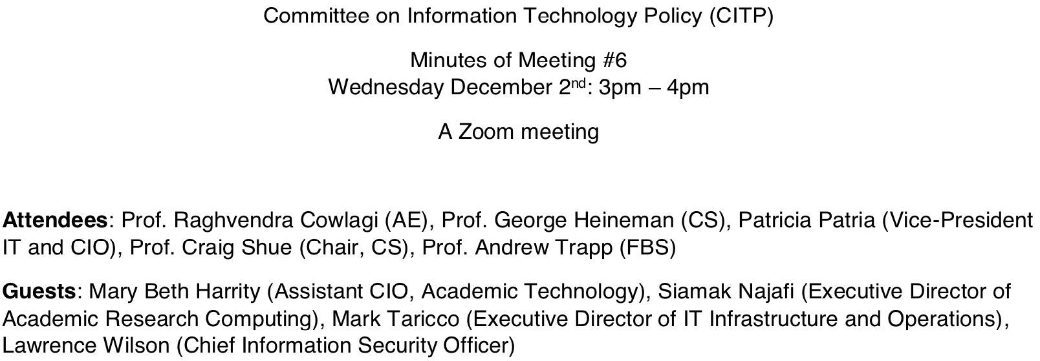
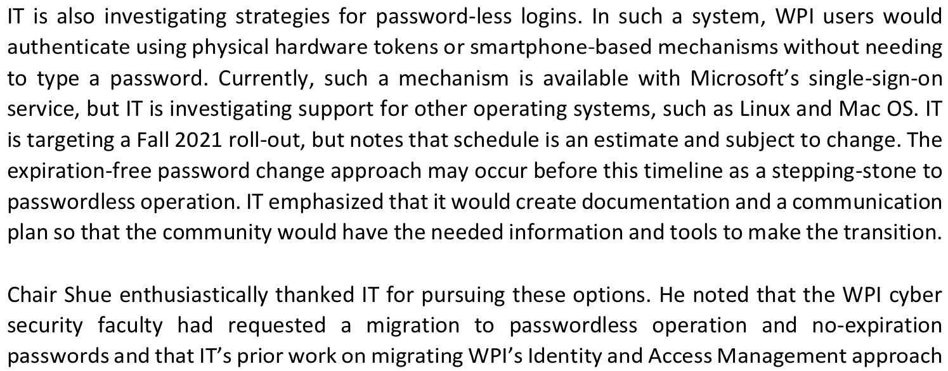
A WPI Perspective….

Slide 41
Course Evaluations
Goals
Feedback on teaching
What worked and what did not
Learning opportunity
Experimenting with course techniques
Evaluation of professor
Ensure WPI teaching remains outstanding
Please be specific when possible
Broad general statements are not actionable
Completed electronically (check email)

Slide 42

The End is Near

